Slide 1
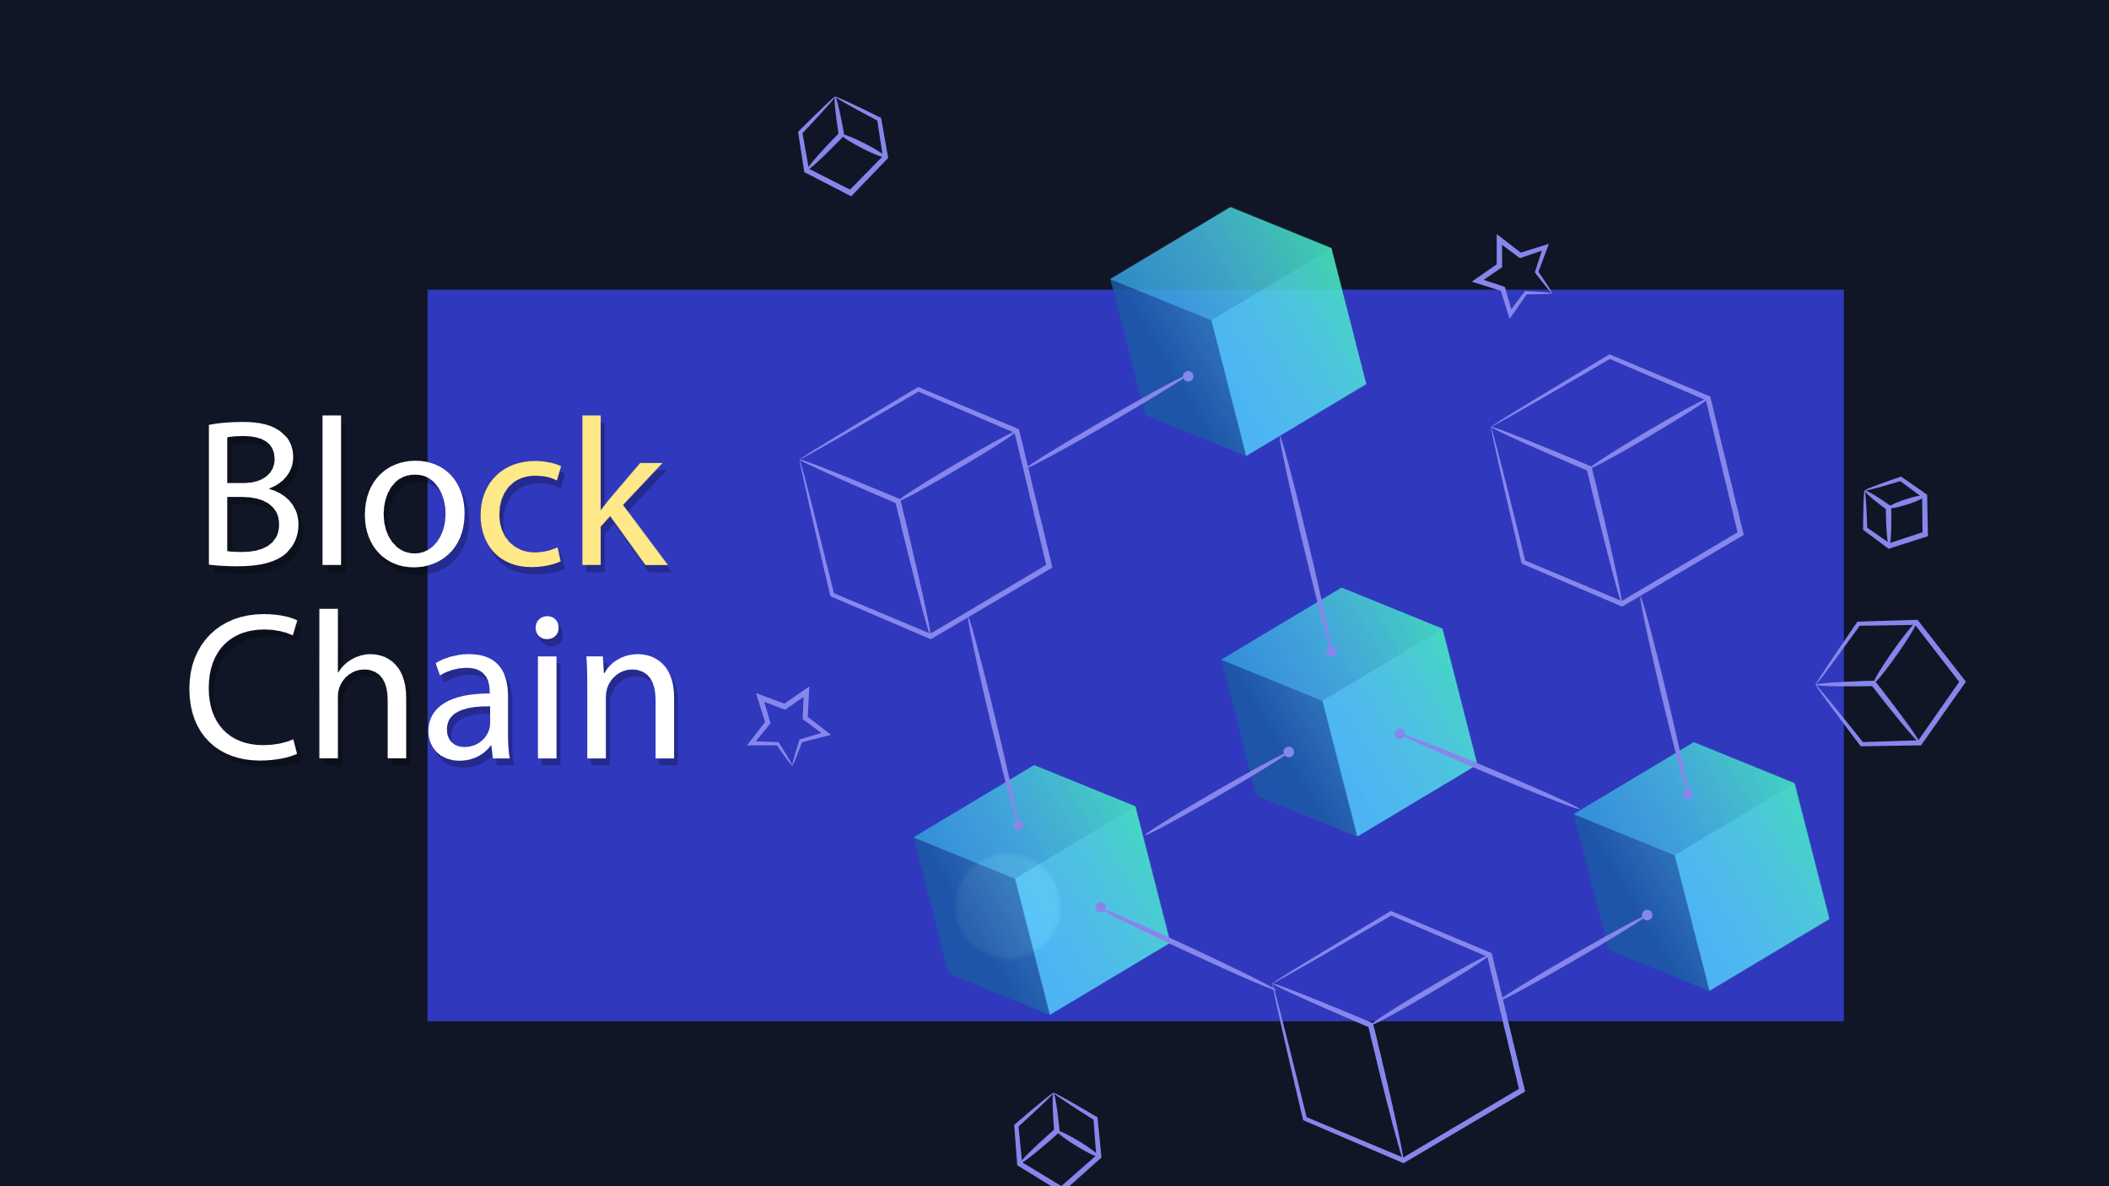
z

Slide 2
What is Block chain ?
Blockchain is a system of recording information in a way that makes it difficult or impossible to change, hack, or cheat the system. A blockchain is essentially a digital ledger of transactions that is duplicated and distributed across the entire network of computer systems on the blockchain
Each node has the entire database, whenever new
Data is to be added it is synced with each node.

Slide 3
Trust Frameworks and Consensus Mechanisms
Consensus, as a concept, is fundamental to any system where more than one entity is participating.
As a public blockchain aims to include any participant that runs a node, there is a need to quickly reach agreement on whether to accept a new block as part of the chain when it is mined. Without the ability to reach this agreement, the blockchain can not create new blocks. A consensus mechanism is a set of rules that allows multiple machines that are connected together to work together while tolerating some machines providing incorrect data or failing completely. A blockchain needs a consensus mechanism to ensure there are a set of rules for creating and accepting each newly created block.

Slide 4
Cryptography in block chain: Public Key Cryptography
If I want to send a message to someone on a public network like blockchain I’ll need two related cryptographic keys, a public one I can share with anyone who wants to send me a message, and a private one that I keep with myself. Let's call them public key A and private key A, because they're a matching pair, like a lock and key. Its a little confusing calling both keys because the public key is used a bit like a lock.
Public key A is used to encrypt or perhaps lock messages and private key A is decrypts messages but only if they were encrypted with the matching public key A. The public key is called that because it can be shared openly,

